Slide 1
Finding the original amount after an increase
Understanding multiplicative relationships: percentages and proportionality

Slide 2
how to use Oak lessons

Slide 3
I can calculate the original value, given the final value after a stated percentage increase.

Slide 4
The reciprocal is the multiplicative inverse of any non-zero number. Any non-zero number multiplied by its reciprocal is equal to 1.

Slide 5

Finding the original amount after an increase
Finding the original value
Using a multiplier

Slide 6
Finding the original value
Alex gives 30% of his sweets to his brother.
His brother gets 15 sweets.
How many sweets did Alex have to begin with?
What would be a sensible partition for the bar model?
10 parts
Let’s set up a bar model.
30%
15 sweets
What will each part represent?
10%

Slide 7
Finding the original value
Alex gives 30% of his sweets to his brother.
His brother gets 15 sweets.
How many sweets did Alex have to begin with?
15 ÷ 3 = 5
So each part (10%) is worth 5 sweets.
30%
5 | 5 | 5 | 5 | 5 | 5 | 5 | 5 | 5 | 5
15 sweets
10 × 5 = 50
Alex originally had 50 sweets.

Slide 8

Finding the original value
The special offer box contains 600 grams.
How heavy is the box usually?
Special Offer
20% extra free
Why have I split the bars into 5 parts?
The whole bar represents 100%, splitting it into 5 parts means each part represents 20%
extra
normal size
600 g = 120% of the usual . weight.
g

Slide 9
Finding the original value
The special offer box contains 600 grams.
How heavy is the box usually?
600 g ÷ 6 = 100g
120%
100 g
100 g
100 g
100 g
100 g
100 g
5 × 100 g = 500 g
The box is usually 500 g

Slide 10
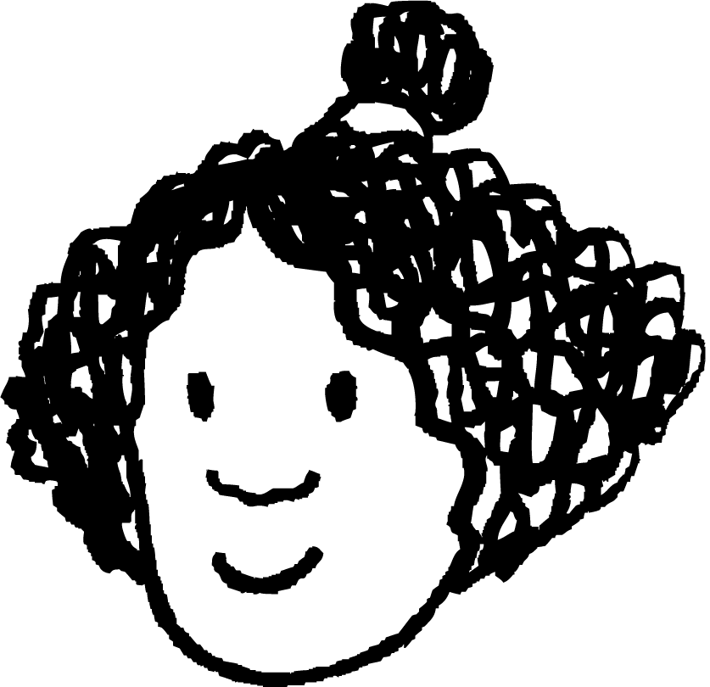

Finding the original value
Alex and Izzy’s teacher thinks of a number and increases it by 20%. The new number is 162. What number was she thinking of?
new number
 |  |  |  |  | 20%
original number
Alex’s workings
162 ÷ 6 = 27
27 × 5 = 135
Izzy’s workings
162 ÷ 6 = 27
162 − 27 = 135
Are both methods appropriate?
Yes, Alex has found 20% and then 100% by multiplying 20% by 5. Izzy has found 20% and then 100% by subtracting 20% from the new number.
Alex
Izzy

Slide 11
Finding the original value
Alex and Izzy’s teacher thinks of a number and increases it by 20%. The new number is 162. What number was she thinking of?
new number
 |  |  |  |  | 20%
original number
Alex’s workings
162 ÷ 6 = 27
27 × 5 = 135
Izzy’s workings
162 ÷ 6 = 27
162 − 27 = 135
When might Izzy’s method be more useful?
Maybe if you were doing it without a calculator.
Alex
Izzy

Slide 12
Finding the original value
Izzy is saving for a new computer game.
When Izzy has saved enough money to buy the game she notices that the price has increased by 40% to £56.
Her mum gives her the extra money to buy the game.
How much had Izzy saved?
Izzy

Slide 13
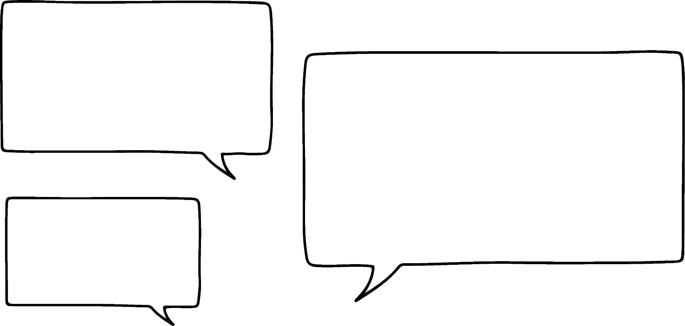
Finding the original value
What would a bar model look like to represent this situation?
Izzy saved the original cost and her mum gave her 40%.
What would be a sensible partition of our bar model if we want to represent 40%?
I would split it into 5 parts and shade 2.
I would split it into 10 parts and shade 4.
Alex
Izzy
Who is right?
They are both right, 100% ÷ 10 × 4 = 40% and 100 ÷ 5 × 2 = 40%

Slide 14
Finding the original value
What would a bar model look like to represent this situation?
Izzy saved the original cost and her mum gave her 40%.
I’m going to use Izzy’s method.
Increased price
£56 ÷ 7 = £8
140%
£8 | £8 | £8 | £8 | £8
£8 | £8
5 × £8 = £40
The game cost £40 originally.
Therefore, Izzy saved £40.

Slide 15

Finding the original value
A number is increased by 25%. The new number is 15, what was the original number?
You may like to sketch a bar model to help you.
15
3 | 3 | 3 | 3
3
4 × 3 = 12
The original number was 12.

Slide 16



Finding the original value
Here is a percentage bar which shows the amount of time a set of traffic lights spent on the three different colours.
100%
50% |  | 45%
Red
Amber
Green
Over this period of time the traffic lights were on amber for 4 minutes.
Work out how long the lights are on red and green.
If we don’t know the total amount of time we cannot find the times for the other colours.
We can, because we know the percentage and time for amber.
Lucas
Laura

Slide 17
Finding the original value
Here is a percentage bar which shows the amount of time a set of traffic lights spent on the three different colours.
100%
50% |  | 45%
5%
4 minutes
What percentage of the bar is amber?
100% − (50% + 45%) = 5%
Yes, and 50% is 10 lots of 5%. Therefore, we multiply 4 by 10.
So, we know that 5% is 4 minutes.
50% = 4 × 10 = 40 minutes
The lights are on red for 40 minutes.
Lucas
Laura

Slide 18
Finding the original value
Here is a percentage bar which shows the amount of time a set of traffic lights spent on the three different colours.
100%
50% |  | 45%
5%
4 minutes
How long are the lights on green?
OK, I get it. So, green will be 9 lots of 4?
Yes, that’s right Lucas because 45% is 9 lots of 5%.
45% = 4 × 9 = 36 minutes
The lights are on green for 36 minutes.
Lucas
Laura

Slide 19
Finding the original value
Here is a percentage bar which shows the amount of time a set of traffic lights spent on the three different colours.
100%
 | 20% | 30%
60 minutes
Red
Amber
Green
Work out how long the lights were on green.
I know that red is 50%. Which means amber and green must be 60 minutes.
How can we use that fact to work out how long the lights were on green?
Lucas
Laura
Help Lucas and Laura to work out how long the lights were on green?

Slide 20
Finding the original value
Here is a percentage bar which shows the amount of time a set of traffic lights spent on the three different colours.
100%
50%
 | 20% | 30%
60 minutes
Red
Amber
Work out how long the lights were on green.
50% of the bar = 60 minutes
10% of the bar = 60 ÷ 5 = 12 minutes
30% of the bar = 12 × 3 = 36 minutes
The lights were on green for 36 minutes.

Slide 21
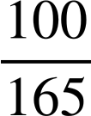
Finding the original value
We can also solve this type of problem with a double number line.
This is more useful when the bar cannot be easily partitioned to show the percentage.
Alex has improved his times tables score by 65%.
His score is now 99
What was his score at the beginning of the year?
×
100
165
%
Alex’s score at the beginning of the year was 60
Score
60
?
99
×

Slide 22
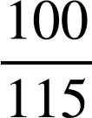
Finding the original value
Jun increased his score by 15%. His new score is 92.
What was his original score?
You could use this double number line to help.
×
100
115
%
Score
Jun’s score at the beginning of the year was 80
80
92
×

Slide 23
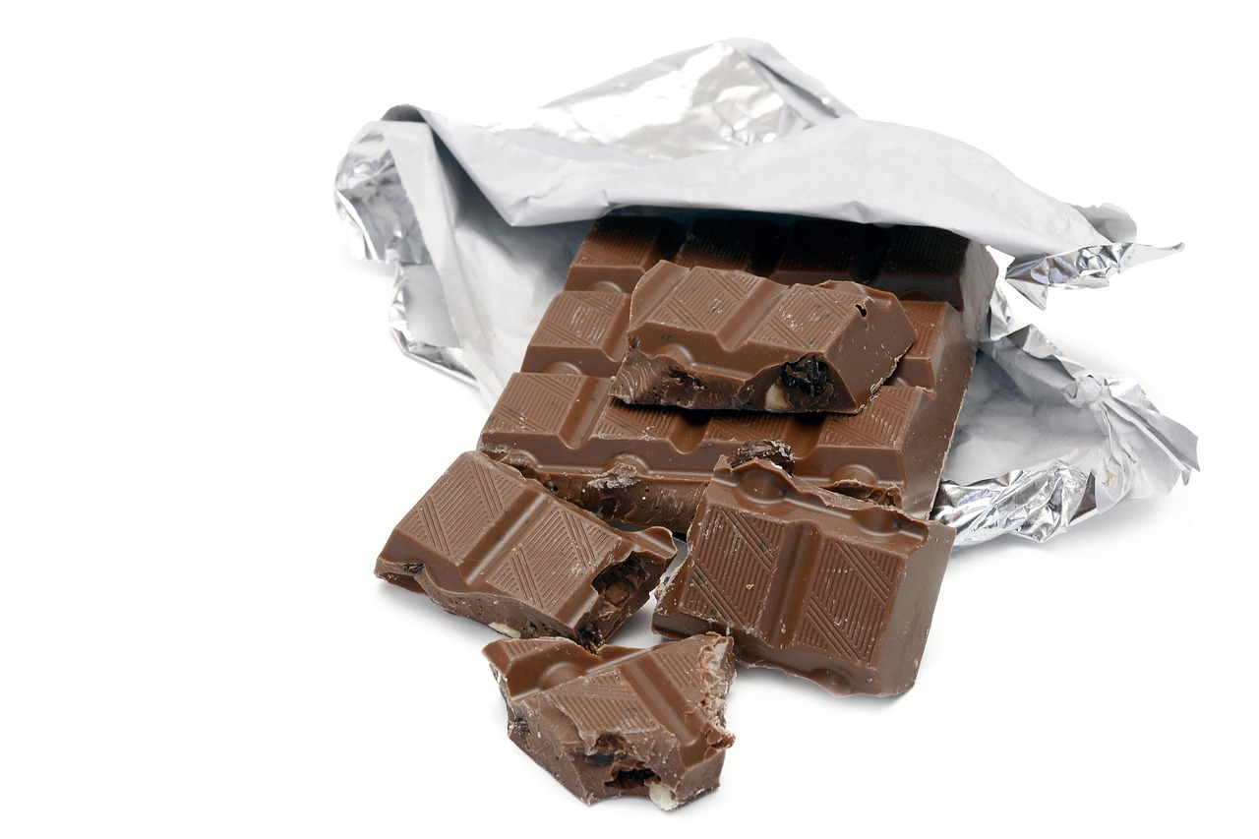
Finding the original value
You can also use a ratio table to solve this type of problem.
A special offer bar of chocolate contains an extra 15%. The special offer bar has a mass of 230 g.
What is the mass of the normal bar?
% | Mass
% | Mass
 | 230
% | Mass
115 | 230
% | Mass
115 | 230
100
% | Mass
115 | 230
100 | 200
×
×
The mass of the normal chocolate bar is 200 g.

Slide 24
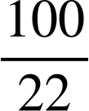
Finding the original value
Spot the mistake.
The cost of a TV increases by 22%. The new price is £512.40
What was the cost of the TV before the price increase?
% | Price
22 | 512.40
100 | 2329.09
×
×
The original cost of the TV is £2329.09
How could they spot their answer must be wrong?
If the cost had increased it must have been less than £512.40 before the increase and £2329.09 is higher than £512.40

Slide 25
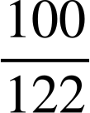
Finding the original value
Spot the mistake.
The cost of a TV increases by 22%. The new price is £512.40
What was the cost of the TV before the price increase?
% | Price
22 | 512.40
100 | 2329.09
122
×
×
420
£420
The original cost of the TV is £2329.09

Slide 26
Finding the original value
Four friends live in different places. They draw bars to show the percentage of days that they experienced different weather.
Work out how many days were sunny, cloudy, rainy or stormy for each person.
Alex
Sofia
Lucas
Jun
50% | 30%
20 days
40% | 20% | 38%
20 days
50% |  | 20%
20 days
30% | 45% | 20%
20 days

Slide 27



Finding the original value
£66
£36.80
£9360
2) Find the original cost for each of these items, given that:
The price of the trainers has increased by 10%.
The price of the sunglasses has increased by 15%.
The price of the car has increased by 17%.

Slide 28
Finding the original value
Four friends live in different places. They draw bars to show the percentage of days that they experienced different weather.
Work out how many days were sunny, cloudy, rainy or stormy for each person.
a)
50% | 30% | 20%
20 days
Percentage | Days
100 | 20
50 | 10
10 | 2
30 | 6
20 | 4

Slide 29
Finding the original value
Four friends live in different places. They draw bars to show the percentage of days that they experienced different weather.
Work out how many days were sunny, cloudy, rainy or stormy for each person.
b)
40% | 20% | 38%
20 days
2%
Percentage | Days
40 | 20
20 | 10
1 | 0.5
38 | 19
2 | 1

Slide 30
Finding the original value
Four friends live in different places. They draw bars to show the percentage of days that they experienced different weather.
Work out how many days were sunny, cloudy, rainy or stormy for each person.
c)
50% | 30% | 20%
20 days
Percentage | Days
50 | 20
10 | 4
30 | 12
20 | 8

Slide 31
Finding the original value
Four friends live in different places. They draw bars to show the percentage of days that they experienced different weather.
Work out how many days were sunny, cloudy, rainy or stormy for each person.
d)
30% | 45% | 20%
5%
20 days
Percentage | Days
5 | 20
30 | 120
45 | 180
20 | 80

Slide 32
Finding the original value
£66
£36.80
£9360
2) Find the original cost for each of these items, given that:
The price of the trainers has increased by 10%. £60
The price of the sunglasses has increased by 15%. £32
The price of the car has increased by 17%. £8000

Slide 33
Finding the original amount after an increase
Finding the original value
Using a multiplier

Slide 34
Using a multiplier
I think of a number and increase it by 15%.
My new number is 55.2
What was my original number?
My new number includes the original number (100%) and the increase (15%).
100% + 15% = 115%
115% of n = 55.2
‘of’ can be exchanged for multiplication
115% × n = 55.2
Without a calculator you can convert to a decimal
1.15 × n = 55.2
I was thinking of the number 48
n = 55.2 ÷ 1.15
n = 48

Slide 35
Using a multiplier
Special Offer
20 % extra free
A special offer bag of sweets has a mass of 336 grams.
What is the mass of the bag usually?
120% of w = 336 g
1.2 × w = 336 g
w = 336 ÷ 1.2
w = 280 g
The bag is usually 280 g.

Slide 36
Using a multiplier
Special Offer
20 % extra free
A special offer bag of sweets has a mass of 336 grams.
What is the mass of the bag usually?
A special offer bag of sweets has a mass of 210 grams.
What is the mass of the bag usually?
120% of w = 336 g
1.2 × w = 336 g
w = 336 ÷ 1.2
w = 280 g
The bag is usually 280 g.
120% of w = 210 g
1.2 × w = 210 g
w = 210 ÷ 1.2
w = 175 g
The bag is usually 175 g.

Slide 37
Using a multiplier
Given the new amount and percentage increase, find the original amount. All of the answers are in the grid except for one.
For i) Write a percentage question that gives this answer.
 | Percentage Increase | New Amount
a | 10% | 357.5
b | 15% | 368
c | 45% | 493
d | 12% | 412.16
e | 36% | 522.24
f | 80% | 630
g | 12.5% | 391.5
h | 3.6% | 326.34
i
320 | 384 | 340
315 | 325 | 350
368 | 330 | 348

Slide 38
Using a multiplier
2) Complete this statement in several different ways.
Increase £ by % = £80
Increase £ by % = £250

Slide 39
Using a multiplier
3) Try to use the multiplier method to answer the following:
A social media manager earns £34 980 a year. This includes a pay rise of 6%. What was their wage before the pay rise?
The cost of a concert ticket is £89.60 This includes an increase of 28% on the previous year. What was the cost of the ticket last year?

Slide 40
Using a multiplier
Given the new amount and percentage increase, find the original amount. All of the answers are in the grid except for one.
For i) Write a percentage question that gives this answer.
 | Percentage Increase | New Amount
a | 10% | 357.5
b | 15% | 368
c | 45% | 493
d | 12% | 412.16
e | 36% | 522.24
f | 80% | 630
g | 12.5% | 391.5
h | 3.6% | 326.34
i | E.g. 35% | 445.5
320 | 384 | 340
315 | 325 | 350
368 | 330 | 348
b
e
c
h
a
f
d
g

Slide 41
Using a multiplier
2) Complete this statement in several different ways.
E.g. Increase £50 by 60% = £80 Increase £40 by 100% = £80 Increase £10 by 700% = £80
E.g. Increase £200 by 25% = £250
Increase £160 by 56.25% = £250
Increase £50 by 400% = £250

Slide 42
Using a multiplier
3) Try to use the multiplier method to answer the following:
A social media manager earns £34 980 a year. This includes a pay rise of 6%. What was their wage before the pay rise? Their new wage includes the original wage (100%) and the pay rise (6%). original wage = £34 980 ÷ 1.06 = £33 000
The cost of a concert ticket is £89.60
This includes an increase of 28% on the previous year.
What was the cost of the ticket last year? Their new ticket includes the original cost (100%) and the increase (28%) original cost = £89.60 ÷ 1.28 = £70

Slide 43
Finding the original amount after an increase
Bar models, double number lines, ratio tables and multipliers can be used to find the original amount.
‘Of’ can often be exchanged for multiplication in maths problems.
Keywords such as profit, extra and interest indicate an increase.

Slide 44

© Oak National Academy 2024.
Produced in partnership with Mathematics in Education and Industry.
Licensed on the Open Government Licence v3.0, except where otherwise stated. See Oak terms and conditions.

